Slide 1
5
INVERSE FUNCTIONS

Slide 2
5.2
The Natural Logarithmic Function

Slide 3
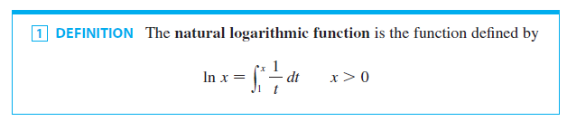
The Natural Logarithmic Function
In this section we define the natural logarithm as an integral and then show that it obeys the laws of logarithms. The Fundamental Theorem makes it easy to differentiate this function.

Slide 4
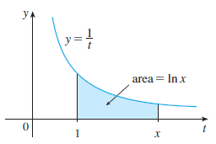
The Natural Logarithmic Function
The existence of this function depends on the fact that the integral of a continuous function always exists.
If x > 1, then ln x can be interpreted geometrically as the area under the hyperbola y = 1/t from t = 1 to t = x. (See Figure 1.)
Figure 1

Slide 5
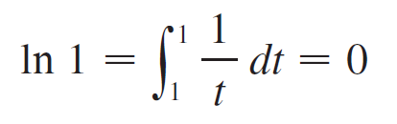

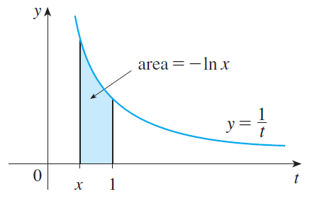
The Natural Logarithmic Function
For x=1, we have
For 0 < x < 1,
And so ln x is the negative of the area shown in Figure 2.
Figure 2

Slide 6
Example 1
(a) By comparing areas, show that ½ < ln 2 < ¾.
(b) Use the Midpoint Rule with n = 10 to estimate the
value of ln 2.

Slide 7
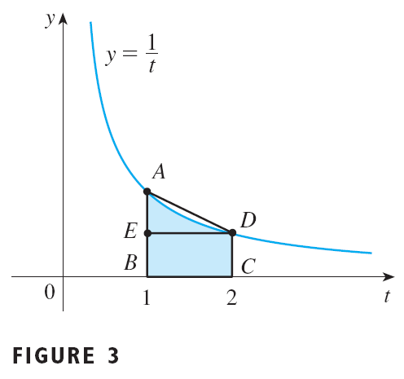


Example 1- Solution
SOLUTION
We can interpret ln 2 as the area under the curve y = 1/t from 1 to 2. From Figure 3 we see that this area is larger than the area of rectangle BCDE and smaller than the area of trapezoid ABCD. Thus we have

Slide 8
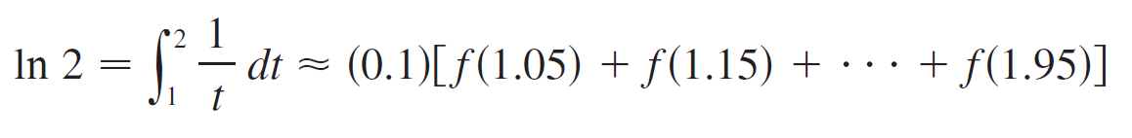
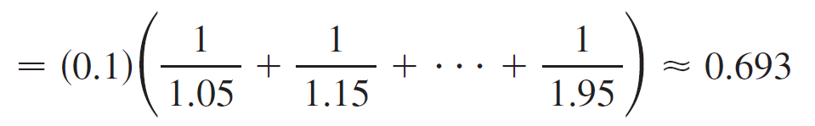
Example 1- Solution
cont’d
(b) If we use the Midpoint Rule with f (t) = 1/t, n = 10, and
∆t = 0.1, we get

Slide 9
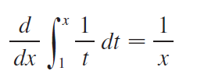
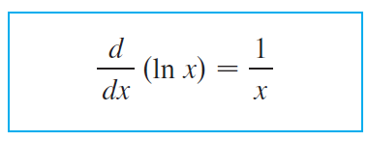

The Natural Logarithmic Function
Notice that the integral that defines ln x is exactly the type of integral discussed in Part 1 of the Fundamental Theorem of Calculus.
In fact, using that theorem, we have
and so

Slide 10
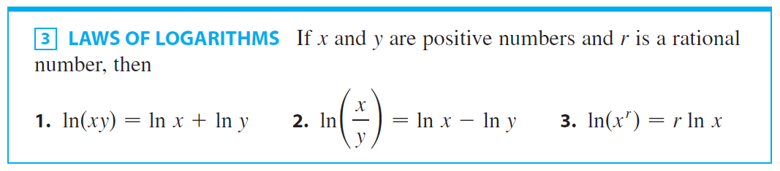
The Natural Logarithmic Function
We can use this differentiation rule to prove the following properties of the logarithm function.

Slide 11
LAWS OF LOGARITHMS PROOF (1)
Let f(x) = ln(ax), where a is a positive constant.
Then, using Equation 2 and the Chain Rule, we have:
Thus, f(x) and ln x have the same derivative.
So, they must differ by a constant:

Slide 12
LAWS OF LOGARITHMS PROOF (1)
Putting x = 1 in this equation, we get: ln a = ln 1 + C = 0 + C = C
Thus,
If we now replace the constant a by any number y, we have:

Slide 13
LAWS OF LOGARITHMS PROOF (2)
Using Law 1 with x = 1/y, we have:
Therefore,

Slide 14
LAWS OF LOGARITHMS PROOF (2)
Using Law 1 again, we have:
The proof of Law 3 is left as an exercise.

Slide 15

Example 2
Expand the expression

Slide 16
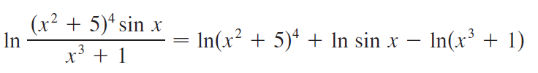

Example 2 - Solution
SOLUTION:
Using Laws 1, 2, and 3, we get

Slide 17
Example 3
Express ln a + ½ ln b as a single logarithm.
SOLUTION
Using Laws 3 and 1 of logarithms, we have:

Slide 18
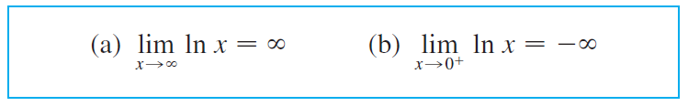

The Natural Logarithmic Function
In order to graph y = ln x , we first determine its limits:

Slide 19
NATURAL LOGARITHMIC FUNCTION PROOF (a)
Using Law 3 with x = 2 and r = n (where n is any positive integer), we have:
Now, ln 2 > 0.
So, this shows that ln(2^{n}) → ∞ as n → ∞.
However, ln x is an increasing function since its derivative 1/x is positive.
Thus, ln x → ∞ as x → ∞.

Slide 20
NATURAL LOGARITHMIC FUNCTION PROOF (b)
If we let t = 1/x, then t → ∞ as x → 0⁺.
Thus, using Formula 4(a), we have:

Slide 21


The Natural Logarithmic Function
If y = ln x, x > 0, then
and
which shows that ln x is increasing and concave downward
on (0, ∞).

Slide 22

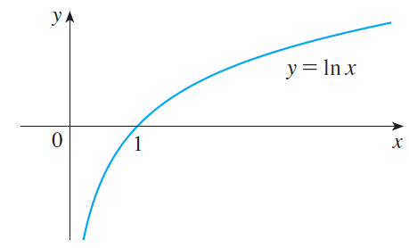
The Natural Logarithmic Function
Putting this information with , we draw the graph of
y = ln x in Figure 4.
Figure 4

Slide 23
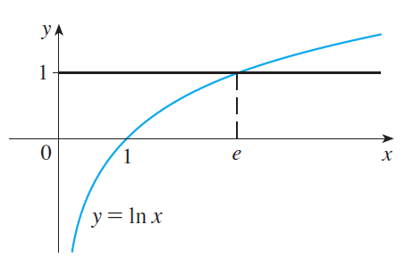
The Natural Logarithmic Function
Since ln 1 = 0 and ln x is an increasing continuous function that takes on arbitrarily large values, the Intermediate Value Theorem shows that there is a number where ln x takes on the value 1 (see Figure 5).
Figure 5

Slide 24

The Natural Logarithmic Function
This important number is denoted by e.

Slide 25
Example 4
Use a graphing calculator or computer to estimate the value of e.
SOLUTION
By Definition 5, we estimate the value of e by:
Graphing the curves y = ln x and y = 1.
Determining the x-coordinate of the point of intersection.

Slide 26
Example 4 SOLUTION
By zooming in repeatedly, as in Figure 6, we find that: e ≈ 2.718

Slide 27
THE NUMBER e
With more sophisticated methods, it can be shown that the approximate value of e, to 20 decimal places, is: e ≈ 2.71828182845904523536
The decimal expansion of e is non-repeating because e is an irrational number.
Now, let’s use Formula 2 to differentiate functions that involve the natural logarithmic function.

Slide 28
Example 5
Differentiate y = ln (x³ + 1).

Slide 29




Example 5 - Solution
SOLUTION:
To use the Chain Rule, we let u = x³ + 1. Then y = ln u, so

Slide 30
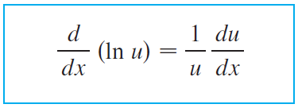
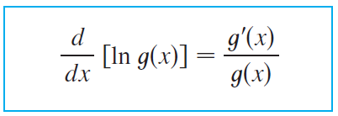

The Natural Logarithmic Function
In general, if we combine Formula 2 with the Chain Rule as in Example 5, we get
or

Slide 31
Example 6
Find
SOLUTION
Using Formula 6, we have:

Slide 32
Example 7
Differentiate
SOLUTION
This time, the logarithm is the inner function.
So, the Chain Rule gives:

Slide 33
Example 8
Find
SOLUTION 1

Slide 34
Example 8 SOLUTION 2
If we first simplify the given function using the laws of logarithms, the differentiation becomes easier:
This answer can be left as written.
However, if we used a common denominator, we would see it gives the same answer as in Solution 1.

Slide 35
Example 8
Figure 7 shows the graph of the function of f Example 8 together with the graph of its derivative.
It gives a visual check on our calculation. Notice that f ‘(x) is large negative when f is rapidly decreasing.

Slide 36
Example 9
Find f ′(x) if f (x) = ln │x│.

Slide 37
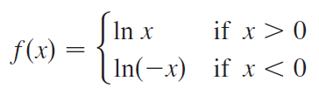
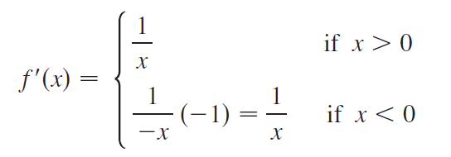

Example 9 - Solution
SOLUTION:
Since
it follows that
Thus f ′(x) = 1/ x for all x 0.

Slide 38
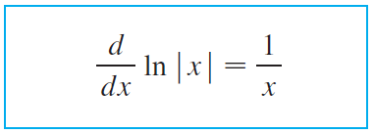

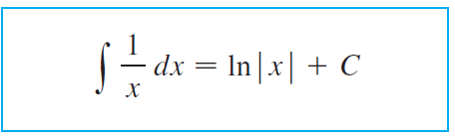

The Natural Logarithmic Function
The result of Example 9 is worth remembering:
The corresponding integration formula is

Slide 39

The Natural Logarithmic Function
Notice that this fills the gap in the rule for integrating power functions:
The missing case (n = -1) is supplied by Formula 8.

Slide 40
Example 10
Evaluate
SOLUTION:
We make the substitution u = x² + 1 because the differential du = 2x dx occurs (except for the constant factor 2).

Slide 41
Example 10 SOLUTION
Thus, x dx = ½ du and
Notice that we removed the absolute value signs because x² + 1 > 0 for all x.

Slide 42
Example 10 SOLUTION
We could use the properties of logarithms to write the answer as:
However, this isn’t necessary.

Slide 43
Example 11
Calculate
SOLUTION
We let u = ln x because its differential du = dx/x occurs in the integral.
When x = 1, u = ln 1 = 0; when x = e, u = ln e = 1.
Thus,

Slide 44
NATURAL LOGARITHMIC FUNCTION
Since the function f(x) = (ln x)/x in Example 12 is positive for x > 1, the integral represents the area of the shaded region in Figure 8.

Slide 45

Example 12
Calculate

Slide 46



Example 12 - Solution
SOLUTION:
First we write tangent in terms of sine and cosine:
This suggests that we should substitute u = cos x, since then du = - sin x dx and so sin x dx = - du:

Slide 47
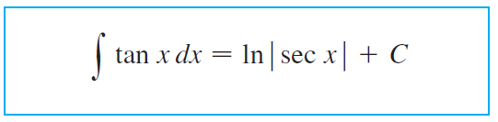

The Natural Logarithmic Function
Since
the result of Example 12 can also be written as

Slide 48
Logarithmic Differentiation

Slide 49
Logarithmic Differentiation
The calculation of derivatives of complicated functions involving products, quotients, or powers can often be simplified by taking logarithms.
The method in the following example is called logarithmic differentiation.

Slide 50

Example 13
Differentiate

Slide 51


Example 13 - Solution
We take logarithms of both sides of the equation and use the Laws of Logarithms to simplify:
Differentiating implicitly with respect to x gives

Slide 52


Example 13 - Solution
cont’d
Solving for dy / dx, we get
Because we have an explicit expression for y , we can substitute and write

Slide 53
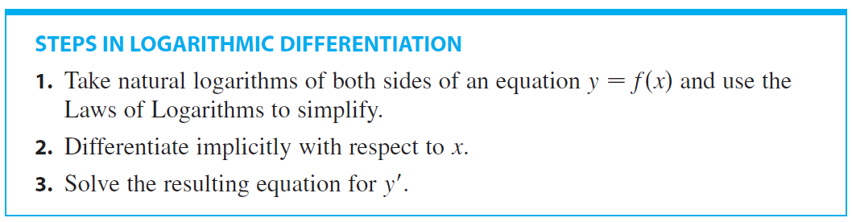
Logarithmic Differentiation
If f (x) < 0 for some values of x, then ln f (x) is not defined, but we can write │y│= │f (x)│ and use Equation 7.

